Slide 1
E-Governance
Application of information and communication technology (ICT) for:
delivering government services,
exchange of information communication transactions,
integration of various stand-alone systems and services between

Slide 2
E-Government
E-government is the use of information technology to support
government operations
engage citizens,
and provide government services.

Slide 3
E-Government
While this definition is simply stated, it is actually quite broad. It incorporates four key dimensions, which reflect the functions of government itself:
E-services: the electronic delivery of government information, programs, and services often (but not exclusively) over the Internet
E-democracy / E-participation : the use of electronic communications to increase citizen participation in the public decision-making process
E-commerce : the electronic exchange of money for goods and services such as citizens paying taxes and utility bills, renewing vehicle registrations, or government buying supplies and auctioning surplus equipment
E-management / E-administration: the use of information technology to improve the management of government, from streamlining business processes to maintaining electronic records, to improving the flow and integration of information

Slide 4
E-Governance refers to the development and enforcement of the policies, laws and regulations necessary to support the functioning of governmental units
E-Government refers to the use of information technologies by government agencies .

Slide 5
Drivers for e-Government
Political : Support, drive and vision from the top
Economical : Cost Reduction and efficiency
Technological: Infrastructure and E-readiness
Legislative and Regulatory : Laws, policies and regulations
Organizational: Focus on transparency, accountability, etc. from gov agencies
External environment: Emergence of e-commerce in pvt sector, regional comparisons, international commitments, etc.

Slide 6
E-Government and Nepalese context
Where do we stand ?

Slide 7
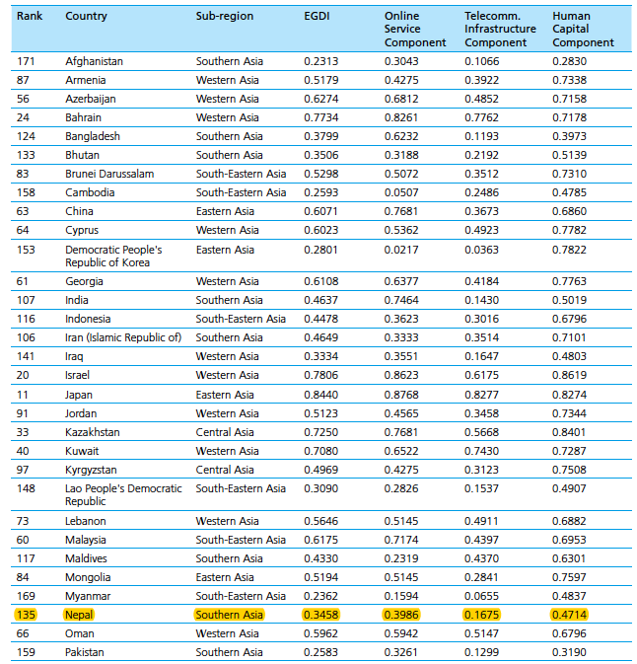


Slide 8
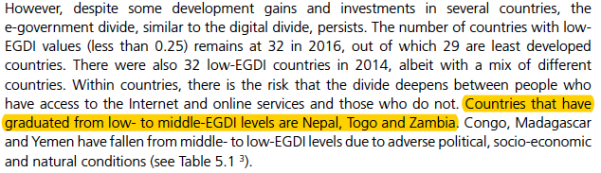

Slide 9
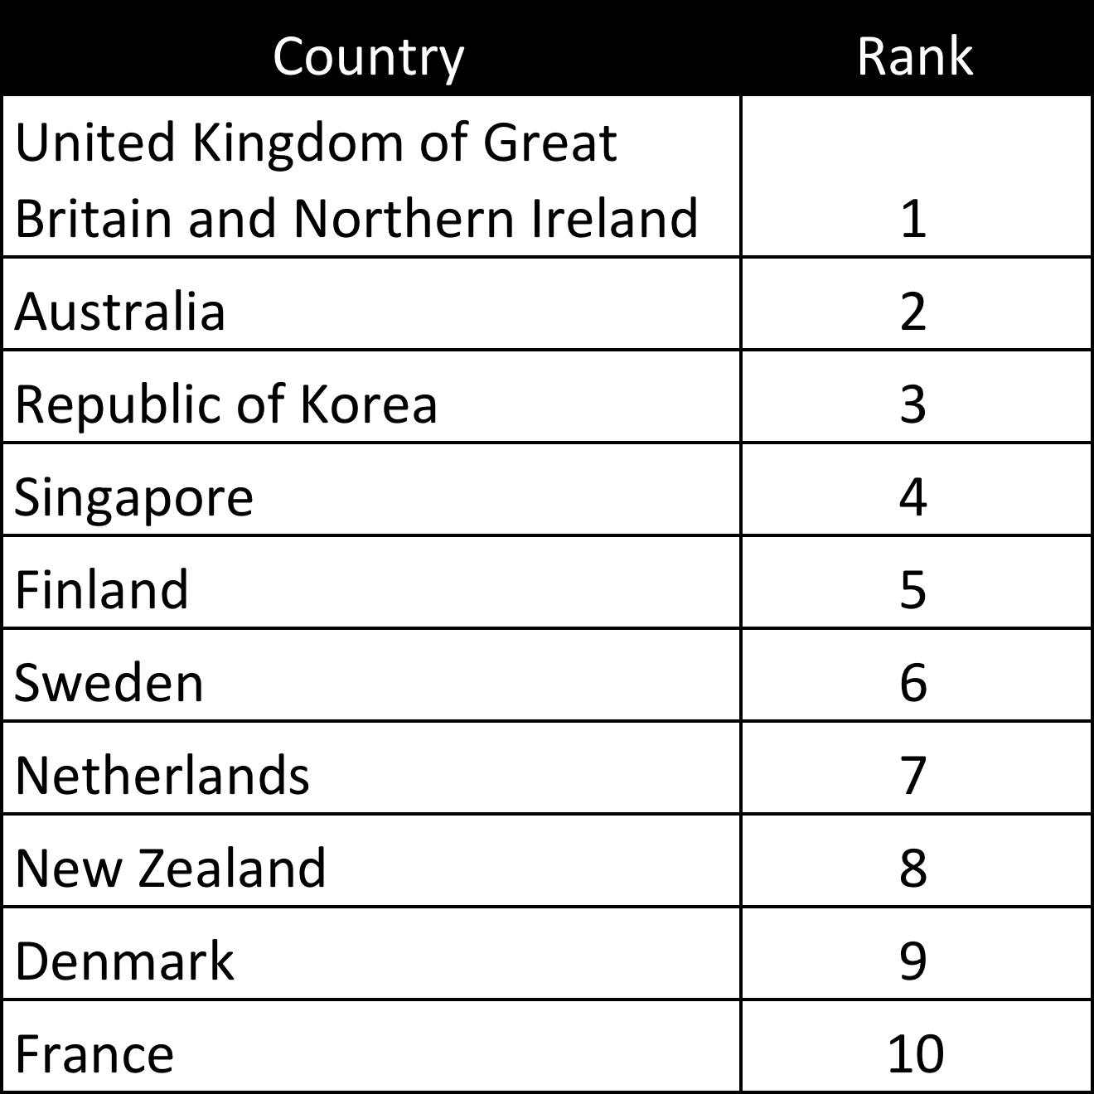
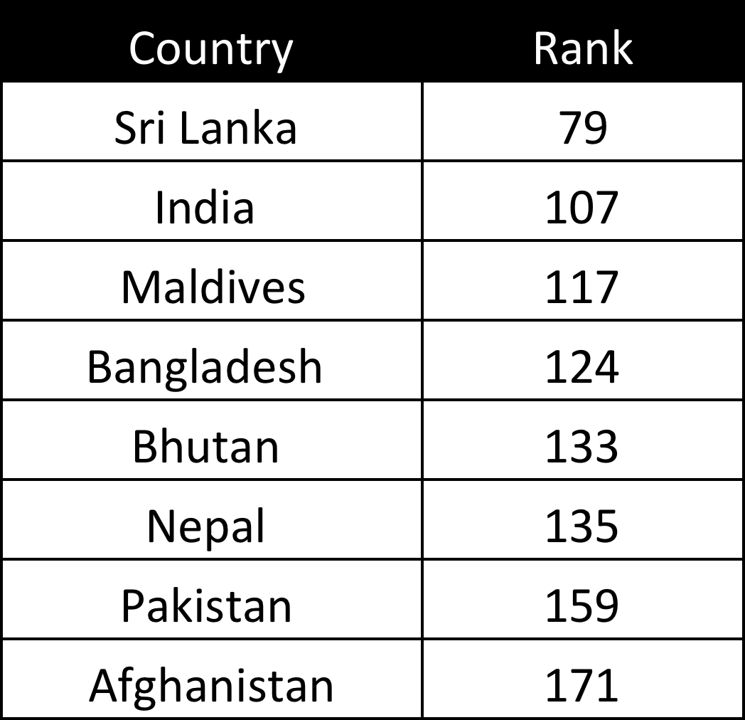

Slide 10
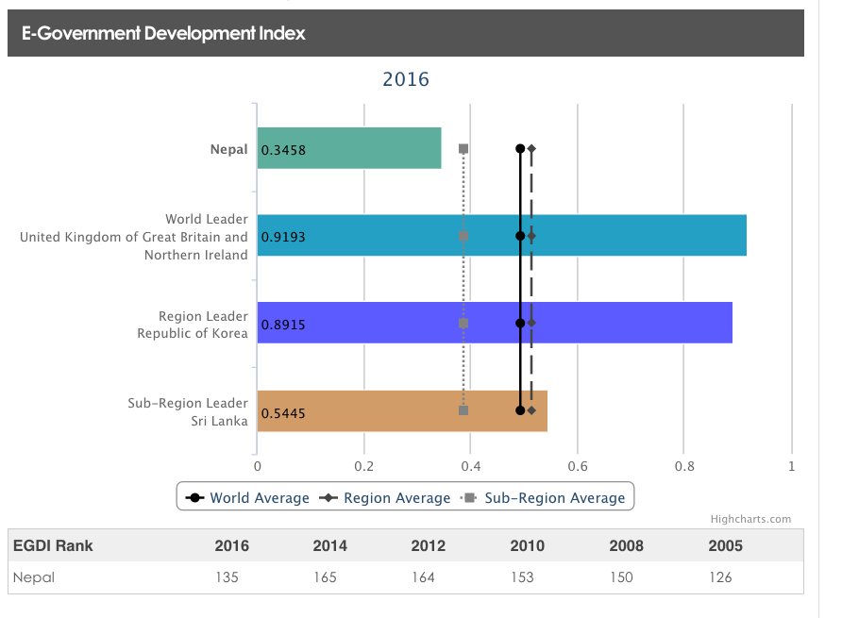

Slide 11
E-Government and Nepalese context
What do we have ?

Slide 12
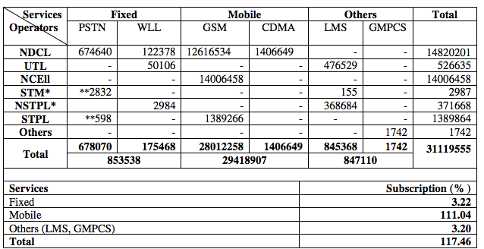
Mobile Penetration in Nepal

Slide 13
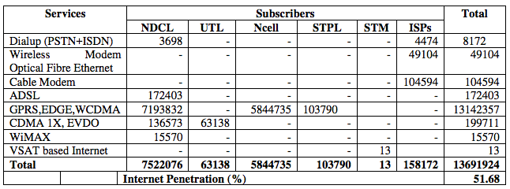
Internet Penetration in Nepal

Slide 14
E-Government Master Plan (eGMP) of Nepal
“Realize good governance and Socio- economic development” by establishing an effective, systematic and productive e-Government

Slide 15
E-Government Master Plan (eGMP) of Nepal
Citizen-centered service
Transparent service
Networked government
Knowledge based society

Slide 16
eGMP Nepal
33 projects in
sectors comprising G2C, G2B, G2G and infrastructure.

Slide 17
eGMP Nepal – Completed/Ongoing Projects and Activities
National Portal – www.nepal.gov.np
Inland Revenue Department (e-VAT, e-PAN, e-Filling, e-TDS)
Office of Company Registrar – online services
Department of Foreign Employment – online tracking of permits
Machine Readable Passport
Financial Comptroller General Office (FCGO) - Government Accounting System
Ministry of General Affairs – Online personnnel records
Business Portal – Licensing requirements for business activities in Nepal
Public Procurement Monitoring Office – eProcurment system
Public Service Commission – Online application
Government Groupware - Email, Chat, Web Conferencing, Document management system, etc.

Slide 18
eGMP Nepal – Upcoming Projects and Activities
E-Customs
Vehicle Registration
National ID
Land Reform Information management system
E-Passport
e-VISA

Slide 19
Policy and Regulatory Frameworks
National Information and Communication Technology Policy 2015 - Ministry of Information and Communication
IT Policy 2000
Electronic Transaction and Digital Signature Act 2063

Slide 20
E-Readiness

Slide 21
E-Readiness
The maturity of citizens, businesses, NGOs and governments for participating in the electronic world (e-commerce, e-government etc.)

Slide 22
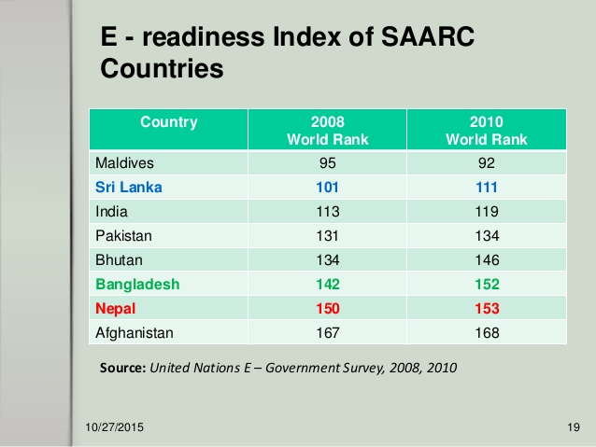

Slide 23
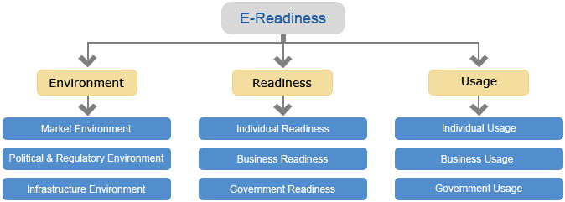

Slide 24
e-Readiness for e-Government
Political Readiness
Regulatory Readiness
Organizational Readiness
Human & Cultural Readiness
Financial Readiness
Communication Readiness
Infrastructure Readiness
Data & Information Readiness

Slide 25
E-Government Challenges for Nepal
Information transparency
Legal issues
Resources availability
Infrastructure including connectivity in rural areas
Capacity and awareness
Political will and government action
Assessment of local needs and customizing e-governance solutions to meet those needs, and
Content (local content based on local language).

Slide 26
E-Government Challenges for Nepal
Top Down
vs
Bottom-up

Slide 27
Emerging Concepts
Open Regime
Open Government Data
Open Contracting
Open Parliament
Civic Engagement and Civic Hackers
Big Data
Internet of Things
Data Science

Slide 28
Knowledge Management
People
Technology
Process

Slide 29
Knowledge Hierarchy
Wisdom
Knowledge
Information
Data

